Slide 1

Data validation techniques
in Excel

Slide 2

Data validation
Data validation is a feature in Excel (and other software) used to ensure that the data entered into a cell or range of cells meets specific criteria or rules. It helps maintain data integrity by restricting the type of data that users can input, thereby reducing errors and improving data quality.

Slide 3
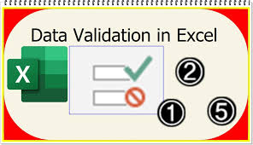
Benefits of data validation
Improved data accuracy:
Ensures that only valid data types and values are entered.
Consistency:
Helps maintain uniformity in data entry across users.
Prevention of Errors:
Blocks incorrect inputs, reducing the need for manual data cleaning later.
User Guidance:
By using input messages, it educates users on what type of information to enter in each cell.

Slide 4
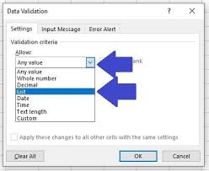
Data validation techniques
Restricting Data to Specific Values
List: Users can select values from a predefined list (e.g., a drop-down menu)
Go to Data > Data Validation > Settings > Allow: List.
Enter values manually or refer to a cell range.

Slide 5
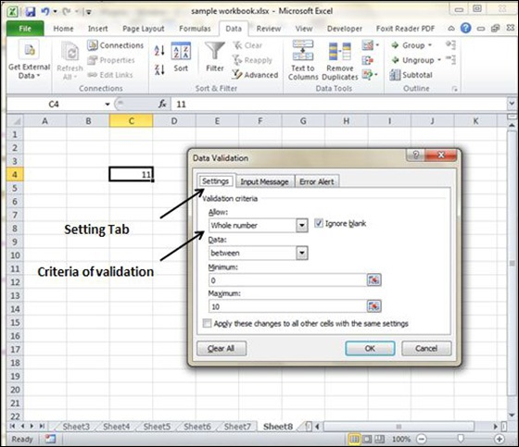
2. Restricting to whole numbers or decimals
.
Limit the input to whole numbers or decimals within a specified range
Go to Data Validation > Settings > Allow: Whole Number/Decimal.
Set conditions like greater than, less than, or between specific values.

Slide 6
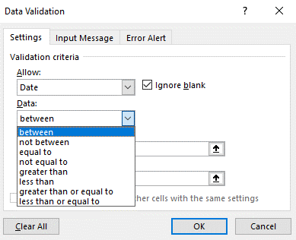
3. Restricting date and time entries
Ensure only valid dates or times within a specified range are entered
Go to Data Validation > Settings > Allow: Date or Allow: Time.
Set start and end dates or times.

Slide 7
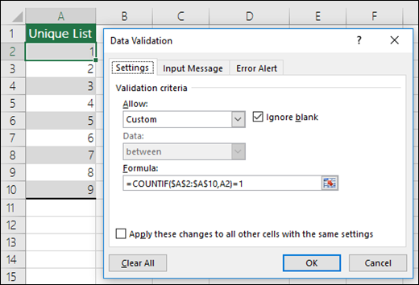
4. Custom formulas for validation
Use custom formulas to create more complex validation rules.
Go to Data Validation > Settings > Allow: Custom.
Enter a formula that returns TRUE or FALSE. For example:
To allow only values greater than 100:=A1>100.
To restrict text length: =LEN(A1) <= 10.

Slide 8
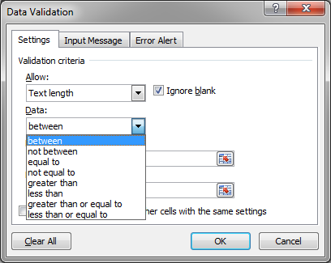
5. Text length
Restrict the number of characters entered in a cell.
Go to Data Validation > Settings > Allow: Text Length.
Set conditions like between, equal to, or less than a specific number of characters.

Slide 9

6. Input message and Error alerts
Input Message: You can show an informative message when a user selects a cell.
Go to Data Validation > Input Message and type a message that will appear when the cell is clicked.
Error Alert: You can display an error message if invalid data is entered
Go to Data Validation > Error Alert, and customize the style (Stop, Warning, or Information) and the message.

Slide 10
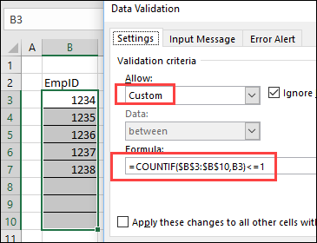
7. Validation for unique values
Ensure that only unique values are entered in a range
Use a custom formula: =COUNTIF($A$1:$A$10, A1) = 1

Slide 11

8. Restricting data using dependent drop-down lists
Create dynamic, dependent drop-down lists (where the options in the second list depend on the selection in the first list) using named ranges and INDIRECT functions.

Slide 12

9. Preventing blank cells
Prevent users from leaving a cell blank.
Use custom formula: =A1 <> " "

Slide 13

10. Circle invalid data
Highlight cells that contain invalid data that doesn't meet validation criteria
Go to Data > Data Validation > Circle Invalid Data.

Slide 14
Conclusion
Overall, data validation is an essential tool in Excel for ensuring data quality and reducing input errors. It’s particularly useful in spreadsheets that will be shared with multiple users or where the data will be used for analysis and decision-making.

Slide 15
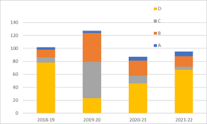

Thank you !!!
ajaycraju98@gmail.com

